Slide 1
Usability Testing Planning and Reporting
Notes from
http://www.usability.gov/methods/test_refine/learnusa/testplan.html

Slide 2
Learning objectives
Be able to develop usability testing plans
Be able to write usability test reports
Understand the nature of human research ethics requirements when conducting studies on humans

Slide 3
Plan EVERYTHING
Use a template such as at http://www.usability.gov/methods/test_refine/learnusa/testplan.html
Fill in ALL the bits – even those that are completely obvious
Take the position that you are planning the test for 5 other people to do, each is in a different part of the world. To be useful all the participants must have the same experience.

Slide 4
Details
Product under test
Exactly what and how is it going to be tested include (as relevant) version numbers etc.
Test Objectives
What’s the goal? What are you planning to measure
Participants
How many and what times of people are to be recruited?
Equipment
Be specific, eg
for desktop specify OS, screen, processor, UI devices.
For web specify device, browse.

Slide 5
Details continued
Test Tasks
Must be detailed and fully described (and tested). See next slide
Test Procedure
Full details see later
Data to be collected
Be specific
Data Analysis Plan
Be specific - test it out.

Slide 6
Participants
Generally it is better if people can be themselves.
Occasionally you need people to role-play
Try to match age, gender and things like first language to the target audience
How many?
10-12 will generally give you good results for a single product
30+ if comparing products and you want statistically valid results.

Slide 7
Task Selection
Utterly central to what you will learn in the usability test
There just isn’t time / resources to do usability testing on everything
Select the tasks that are ‘make-or-break’ for the application
You’re looking for the risk
What’s novel? What will differentiate this product?
If you’re in a ‘safe’ zone where you’re emulating well-established interaction patterns, then you’ll learn less
Then again, still can be important to check that you got it right!

Slide 8
Task Design
Be specific*
“enrol in COMPSCI345 at the University of Auckland”
“what lecture room(s) are COMPSCI345 lectures in?”
Record Completion Paths
Step through the task yourself
Record different routes to successfully complete
Time yourself
Note things you think are difficult or confusing
You are, in effect doing a Heuristic Evaluation (assignment 1 is pretty much this with thorough documentation)
Remember these are notoriously inaccurate (users will surprise you)
Do not show these to participants
* See next slide

Slide 9
Task Order
For you assignment you need to think carefully about task order.
Do you want to fix the order – eg everyone does cash, then credit card then txt
Do you want to ‘latin square’ – eg every variation of order (there are six)
What do you think the difference would be?
This is called the learning effect.

Slide 10
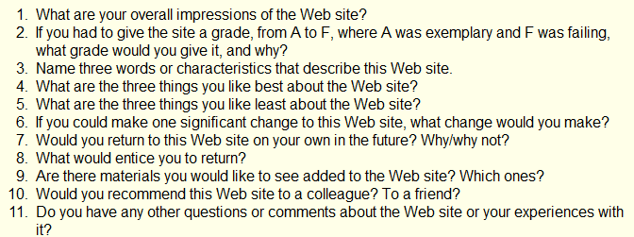
Questionnaire
The easiest way to gather satisfaction data is a questionnaire
There are several ‘standard’ questionnaires
http://www.usabilitynet.org/trump/documents/Suschapt.doc
http://www.w3.org/WAI/EO/Drafts/UCD/questions.html#posttest

Slide 11
Questionnaire – open and closed
Open questions (as per previous slide) give you rich qualitative data
Best for finding the seeds of resolutions to problems
Closed questions allow you to quantify
Would you recommend this website to a friend? [Circle one] YES NO
Yes/No is OK, but better to use Likert scale
This website is easy to use: Strongly Agree Agree Disagree Strongly Disagree
Converts to scores (1-4, 1-7, etc.), can report mean and other statistics and graphs
There’s a whole world to writing questionnaires; starter: http://www.terry.uga.edu/~rgrover/chapter_5.pdf

Slide 12
Procedures
Don’t under-estimate the practical problems
If you get something wrong you can lose a lot of time (and, in most situations, money) having to reschedule
Running a pilot or walkthrough can help here
Have you figured out…
How to pay / reward participants?
Any catering for longer session (including your staff if the experiment is in the ‘field’)?
Do you have enough power points and battery life?
Enough storage capacity (e.g. on your digital camera)?
The time and ability to ‘reset’ in between participants?

Slide 13
Details (not on that sample template!)
Analysis plan
How are you going to turn the raw observations into assessment against your usability requirements, and into recommendations?
It’s one thing to declare ‘time’ as a metric and plan to collect video, but have you defined exactly which elements of the task you are timing, and the protocol for marking the task time?
Is your method practical and accurate? Will it support the overall purpose of your usability test
What is your plan for how to report the findings
What, to whom, when and toward what follow-up action?

Slide 14




Half time entertainment
https://www.youtube.com/watch?v=3Qg80qTfzgU

Slide 15
Write a Script
Back to the test plan…
Script the usability study EXACTLY
Greeting
Ethics
Task instructions
Questionnaire
If you don’t have a script you WILL get lazy and miss instructions for later participants.

Slide 16
Data Collection
Metrics
What will you measure/collect
Video
Errors
Time
Observations
Questionnaire
How many people do you need during tests?
Participant guide
Observer

Slide 17
Analyse Results
Task time and success
Errors – you’ll want counts and to form categories
Wrong navigation
Problems finding particular features
……….
Questionnaire analysis
If around 10 people or less, show raw data, mean and standard deviation
If more than 10 people, box plots or frequency distribution graphs might be appropriate

Slide 18
Pilot Test
Try the whole thing out on one or two people (or more if it’s a really important and large usability study)
After first person fix obvious problems
If very few corrections needed in test plan then you can go straight to testing
But it is much better to do a second pilot than discover major problems half way through

Slide 19
Analyse
Summarize information into tables
Use numbers where you can
Classify comments into groups
Run statistics as appropriate

Slide 20
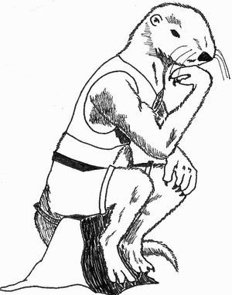
Think!
The big picture
What have you found?
What is worth fixing?
Is there a business case?
How could the problems be alleviated?

Slide 21
Report
Document
Detailed report of everything you have found
Three formats here
http://www.usability.gov/templates/index.html
Remember numbers are very convincing, compare:
Several people had trouble finding the shopping basket
3 out of 7 people abandoned the task because they couldn’t find the shopping basket. For the other 4 the average time to find the shopping basket was 3.59seconds (longest 8.0 seconds)
Video
Imagine clipping together the 7 people looking for the shopping basket icon … with puzzled looks on their faces!

Slide 22
Ethics
If you are doing a study with living (human or animal) participants in a university you will probably need ethics approval
Can be quite a lot of paperwork, and takes a while to get an answer (which is usually to revise and re-submit!)
You will need such approval for a study to be part of your dissertation or thesis
Many journals require such approval to publish
Quite a few companies have similar requirements
This is why for your assignment you are not testing on others – though you could ask classmates…

Slide 23
Research ethics basics
Informed consent
Participant knows what they are ‘in for’
Task, time, why you’re doing it (even though you may be allowed to ‘deceive’ them about some aspect of the task)
Confidentiality of their data
Compensation (if any)
Participant is clear that they are not compelled to participate
This is a bit of a trick in lecturers experimenting on their students! (or doctors on patients, or bosses on their employees)
They need to know that they can refuse, or withdraw (even retrospectively!) without jeopardising the key service (healthcare, education, employment)
Anonymous questionnaires, esp. in public, are probably the easiest from an ethics perspective

Slide 24
Ethics application
Explains protocol and goals: essentially like a test plan
And so it’s helpful to complete one because it acts as a check on your plan
Particular focus on issues such as who has access to the data and the risk (and benefits, if any) to participants
Research organisations (University, District Health Board) have standing committees to review applications
Have representatives from a range of perspectives: clinical, legal, statistical (and Maori in NZ)

Slide 25
Professionalism
Treat participants with respect
Assume they are not idiots, it is the software that is wrong
Treat developers with respect
They may have put their heart and soul into the product and worked overtime to get if finished for you to pull it apart
Make sure your report is
Fair and accurate
Tidy
Free from grammar and spelling errors

Slide 26

In the real world
If you can’t do a ‘real’ usability test
Get your mates, Mum, Dad, Aunty Flo to try it
Tune-in to your own usability experiences
Note what was really easy
that’s a sign of good usability
Note what is annoying you
Note when you are trying to do something you have done before and can’t remember how.

Slide 27
Summary
Evaluate usability early and often in development and [preferably staged] roll-out
Also evaluate alternatives before making a decision to purchase/adopt a system
You need a complete and detailed testing plan
Heuristic evaluation is a handy intermediate level between just asking a couple people for feedback and doing a full-blown usability study

